Slide 1

KIEBIE analysis of Qushuojingying English

Slide 2
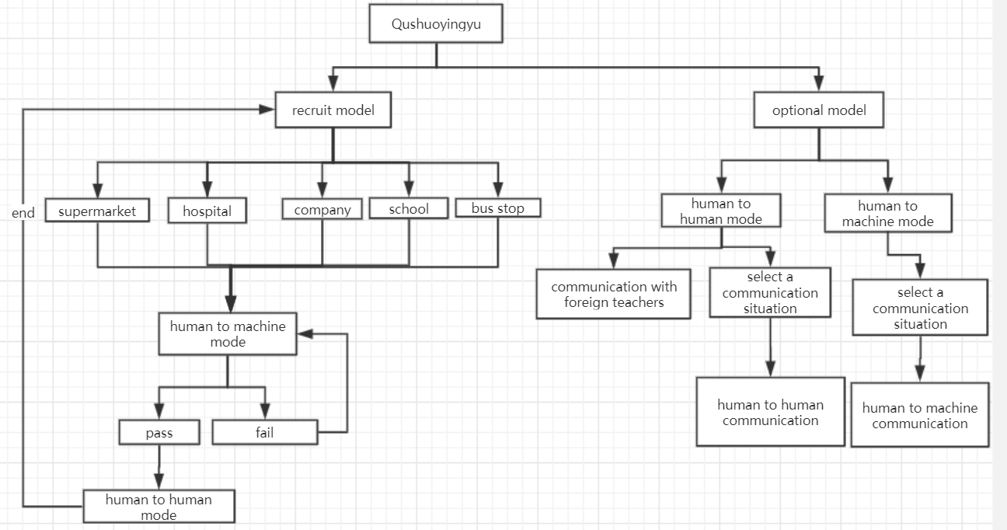
标题

Slide 3
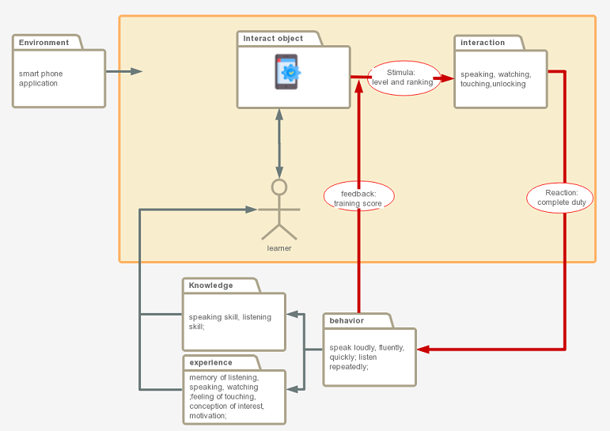
标题

Slide 4
environment
smart phone；connect with WIFI
Interact object
machine
interaction
dialogue, watching, touching
Behavior
In the app, when learners practice a content repeatedly, their dialogue patterns and pronunciation will gradually form a specific behavior of their own.
experience
the memory of pronunciation, mouth shapes and intonation can be acquired；feel a sense of accomplishment after completing each level
Knowledge，skill，attitude
improve their speaking and listening skills；build confidence in speaking and learning English

Slide 5
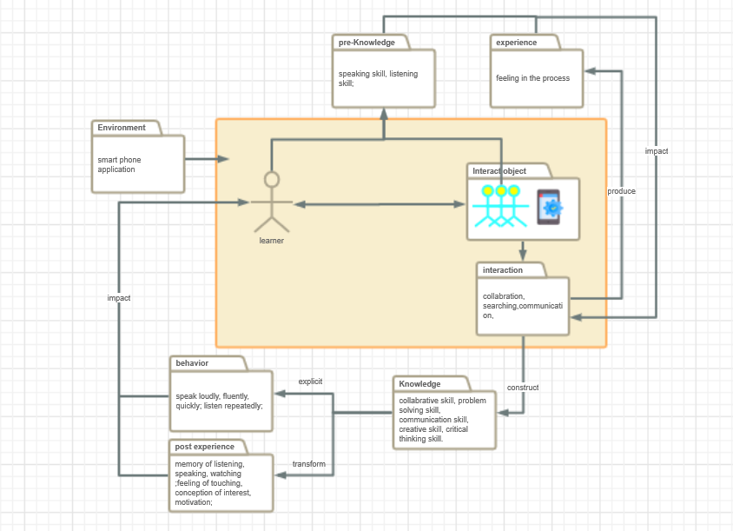
标题

Slide 6
environment
smart phone；connect with WIFI
Interact object
Machine；human
interaction
communicate or collaborate with other real people and play a unique role in the virtual context；complete or trace their training duty by interacting with machine.
Behavior
if the learner has completed the meaningful knowledge construction, then he will speak loudly, fluently and quickly in the following oral English-speaking practice
experience
feeling of communication and collaboration with partner；
the memory formed by users’ practical experience；
emotional experiences such as confidence and joy gained
Knowledge，skill，attitude
learners re-understand and re-construct the meaning of knowledge in the process of social interaction

Slide 7
谢谢
Thank you！

